Slide 1

Department of Computer Science Gujarat University Master of Computer Application Code Auto Evaluation
Presented by
Ajinkya Rathod (60024)
Under the Guidance of
Dr. Hardik Joshi

Slide 2
Table of Content
Project Profile
Company Profile
Project Description
System Design
Data Dictionary
Screenshots
Future Work
Bibliography

Slide 3
Project Profile
Aim : Automated code evaluation
Developed For : Incubyte Consulting LLP
Project Duration : 6 months
Technology : Ruby on Rails, Django
Tools : IntelliJ, Visual Studio Code

Slide 4

Company Profile
Incubyte is a remote-first company that helps its
clients craft future-ready software products that
can adapt to changing business needs.
Founded in 2020
It is powered by software professionals from over
15 cities, to converge on projects across the globe
They passionately believe in giving back to the software development community and try our best to promote modern best practices
We believe that people make “all” the difference

Slide 5
Problem Facing
Took long time to evaluate lot of repos
Need to see each repo individually

Slide 6
Advantages
Providing your company with a competitive edge
Online recruitment provides your hiring team with a better applicant pool
Online recruitment saves time and money by using automation to screen applicants

Slide 7
How can our company use online recruitment?
Company website. Our company website is the starting point to showcase your workplace culture and show people that you should be their employer of choice. You can post job listings on your company website and let your applicants know about your company culture
Depending on the size of your business, we can have a simple page dedicated to recruitment or a separate site altogether. To boost the effectiveness of your company website's career page, include videos or testimonials from current employees about why they love to work with you.

Slide 8
Reach a wider audience with internet recruiting
With online recruitment, you can reach a more targeted and wider audience. If you’re recruiting applicants for remote work, you can reach job seekers in any country.
You can also use recruiting job boards to specifically target different industries and professional associations to ensure only the right people see and apply for your vacancy.

Slide 9
Online recruitment brings more job applicants
When using online recruiting, you benefit from more applicants because your job reaches a wider area.
Consider that a survey has found that 79% of all people in the US use online resources to search for jobs. The Internet is a go-to resource to find different kinds of jobs. As a company and recruiter, you need to be where your candidates are looking.
Submitting your vacancies to the right job boards and recruiting platforms will boost the number of quality applications you receive.

Slide 10
Create a better candidate experience with e-recruiting tools
If done correctly, online recruitment can increase the candidate’s experience and, therefore, their perception of your brand.
These reviews hold a lot of power and, if a candidate had a negative experience, they could dissuade someone suitable from applying. Therefore, when using online recruitment, ensure that you treat every candidate, whether successful or not, with respect. Even if a candidate is successful and you've hired them, their experience during hiring will determine whether they stay with your company long-term.

Slide 11
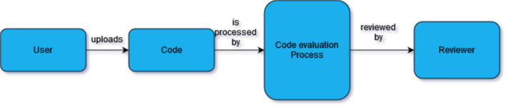

Slide 12
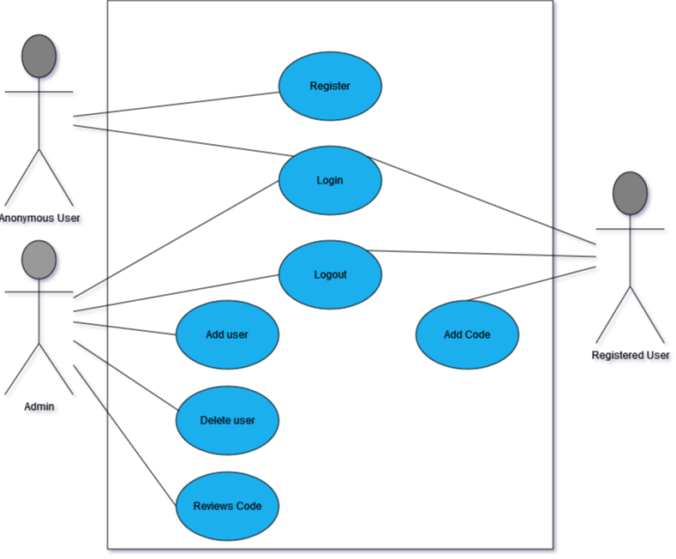
Automated Tool
Use case Diagram

Slide 13
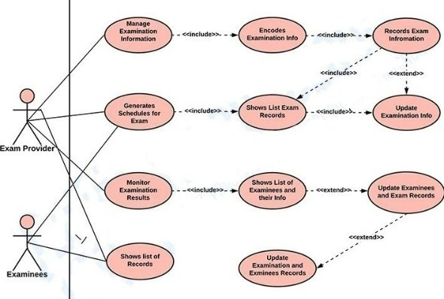
Use Case Diagram

Slide 14
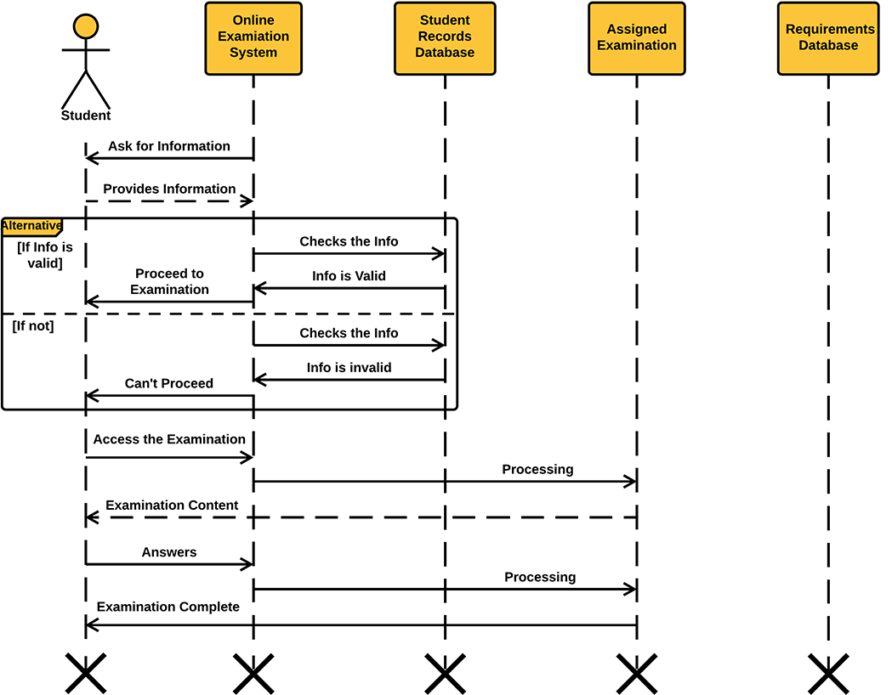
Sequence Diagram

Slide 15
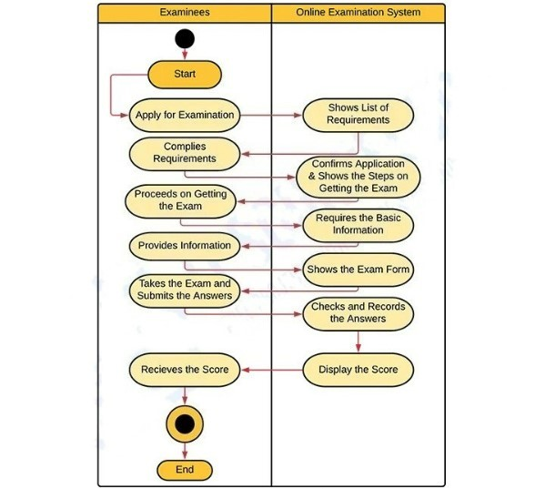
Activity Diagram

Slide 16
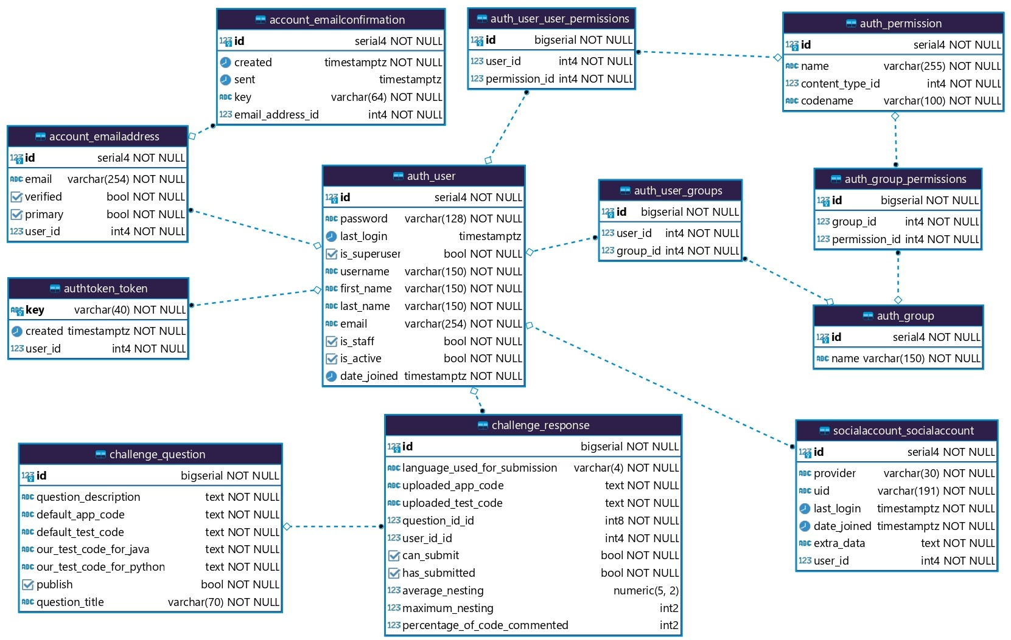
Class Diagram

Slide 17
Data Dictionary Users Table
# | Name | Datatype | Constraint
1 | Id | big int | PRIMARY KEY
2 | Username | string | NOT NULL
3 | First name | string | NOT NULL
4 | Last name | string | UNIQUE
5 | Email | string | NOT NULL
6 | Password | string | NOT NULL
7 | Is Active | boolean | NOT NULL
8 | Is Staff | boolean | NOT NULL
9 | Is Superuser | boolean | NOT NULL
10 | Date Joined | Imestamp | NOT NULL
11 | Last Login | timestamp | NOT NULL

Slide 18
Data Dictionary Question Table
# | Name | Datatype | Constraint
1 | Id | big int | PRIMARY KEY
2 | Question Title | string | UNIQUE
3 | Question Description | string | NOT NULL
4 | Default App Code | string | NOT NULL
5 | Default Test Code | string | NOT NULL
6 | Test Code for Java | string | NOT NULL
7 | Test Code for Python | string | NOT NULL
8 | Publish | boolean | NOT NULL

Slide 19
Data Dictionary Response Table
# | Name | Datatype | Constraint
1 | Id | big int | PRIMARY KEY
2 | Language used | string | NOT NULL
3 | App Code | string | NOT NULL
4 | Test Code | string | NOT NULL
5 | Question Id | big int | FOREIGN KEY
6 | User Id | big int | NOT NULL
7 | Can Submit | boolean | NOT NULL
8 | Has Submitted | Boolean | NOT NULL
9 | Average Nesting | decimal(5, 2) | -
10 | Maximum Nesting | int(2) | -
11 | Code Commented % | int(2) | -

Slide 20
Online Editor
Online Editor is created in Ruby on Rails
Is a robust, scalable online code execution system.
You can use it to build a wide range of applications that need online code execution features.
Some examples include competitive programming platforms, e-learning platforms, candidate assessment and recruitment platforms, online code editors, online IDEs, and many more.

Slide 21
Advantages
Modern modular architecture
Easily deployed
Easily scaled
Quick and easy installation

Slide 22
Features
Support for 3 programming Languages
Support for custom user-defined compiler options, command-line arguments, and time and memory limits
Detailed execution results
Webhooks (HTTP callbacks)

Slide 23
Sending Requests
http://127.0.0.1:2358/submissions
{
"source_code": "public class Main{public static void main(String args[]){System.out.println(\"hello\");}}",
"language_id": "62",
"number_of_runs": "1",
"stdin": “-",
"expected_output": null,
"cpu_time_limit": "2",
"cpu_extra_time": "0.5",
"wall_time_limit": "5",
"memory_limit": "128000",
"stack_limit": "64000",
"max_processes_and_or_threads": "60",
"enable_per_process_and_thread_time_limit": false,
"enable_per_process_and_thread_memory_limit": false, "max_file_size": "1024"
}

Slide 24
First Response
{
"token": "15f38fc2-73a1-43e2-9832-8e05d4fc1630“
}

Slide 25
Next Request at received response
http://127.0.0.1:2358/submissions/15f38fc2-73a1-43e2-9832-8e05d4fc1630
{
"stdout": "hello\n",
"time": "0.046",
"memory": 55648,
"stderr": null,
"token": "15f38fc2-73a1-43e2-9832-8e05d4fc1630",
"compile_output": null,
"message": null,
"status":
{
"id": 3,
"description": "Accepted"
}
}

Slide 26
SCREENSHOTS

Slide 27
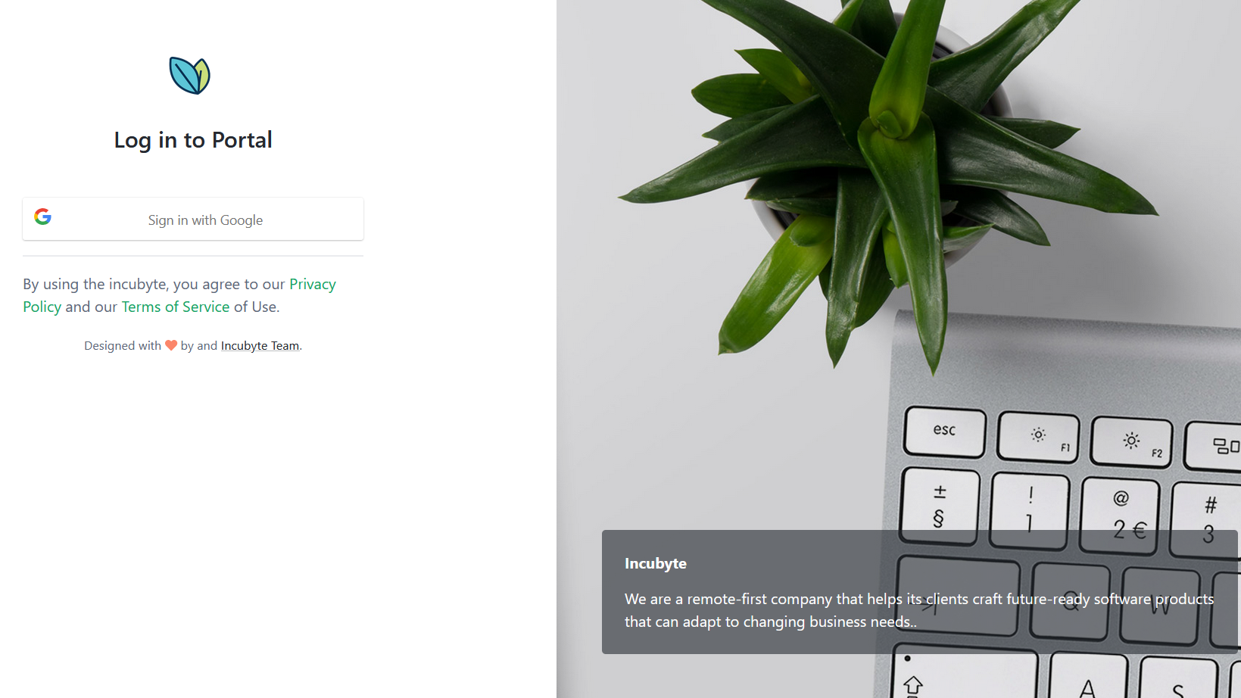

Slide 28
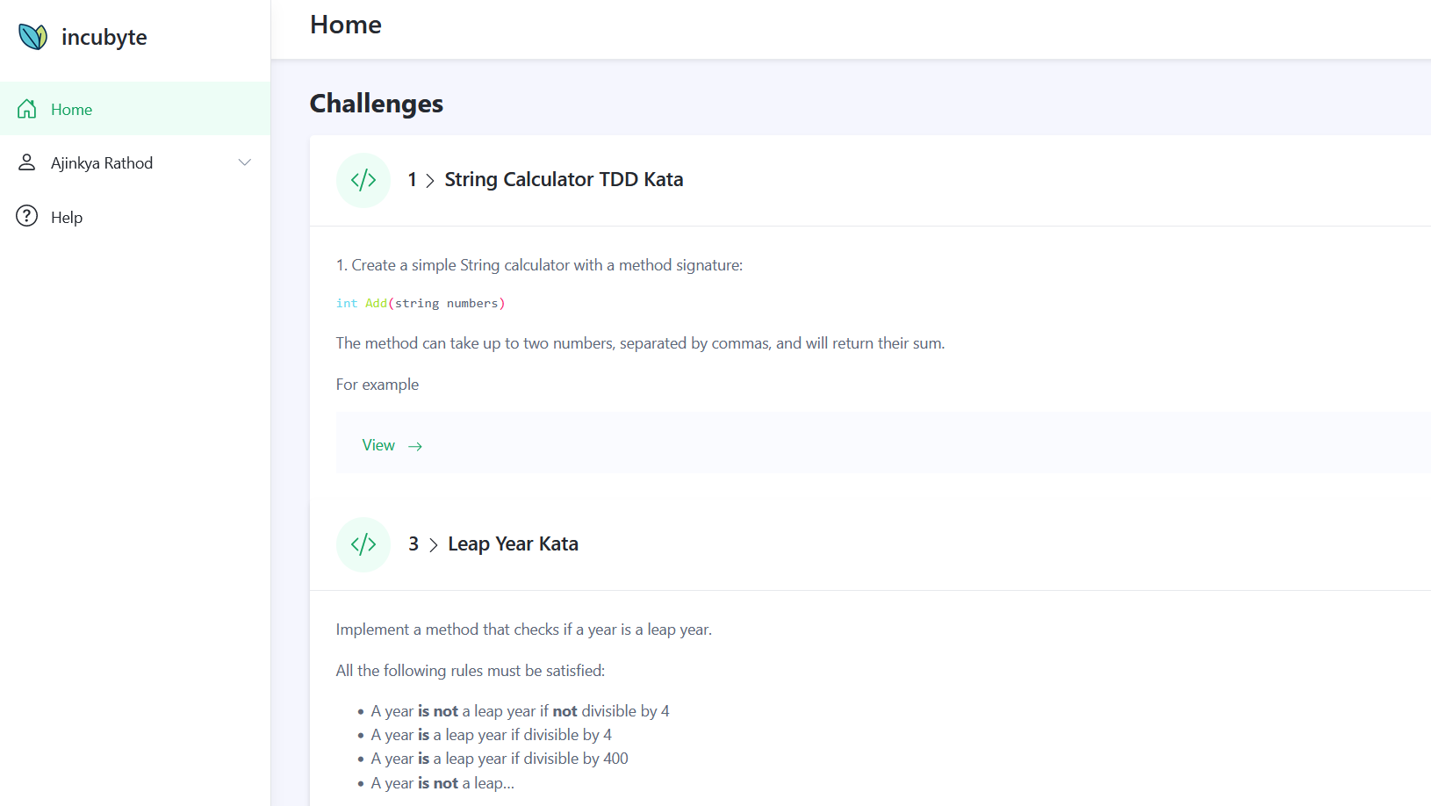

Slide 29
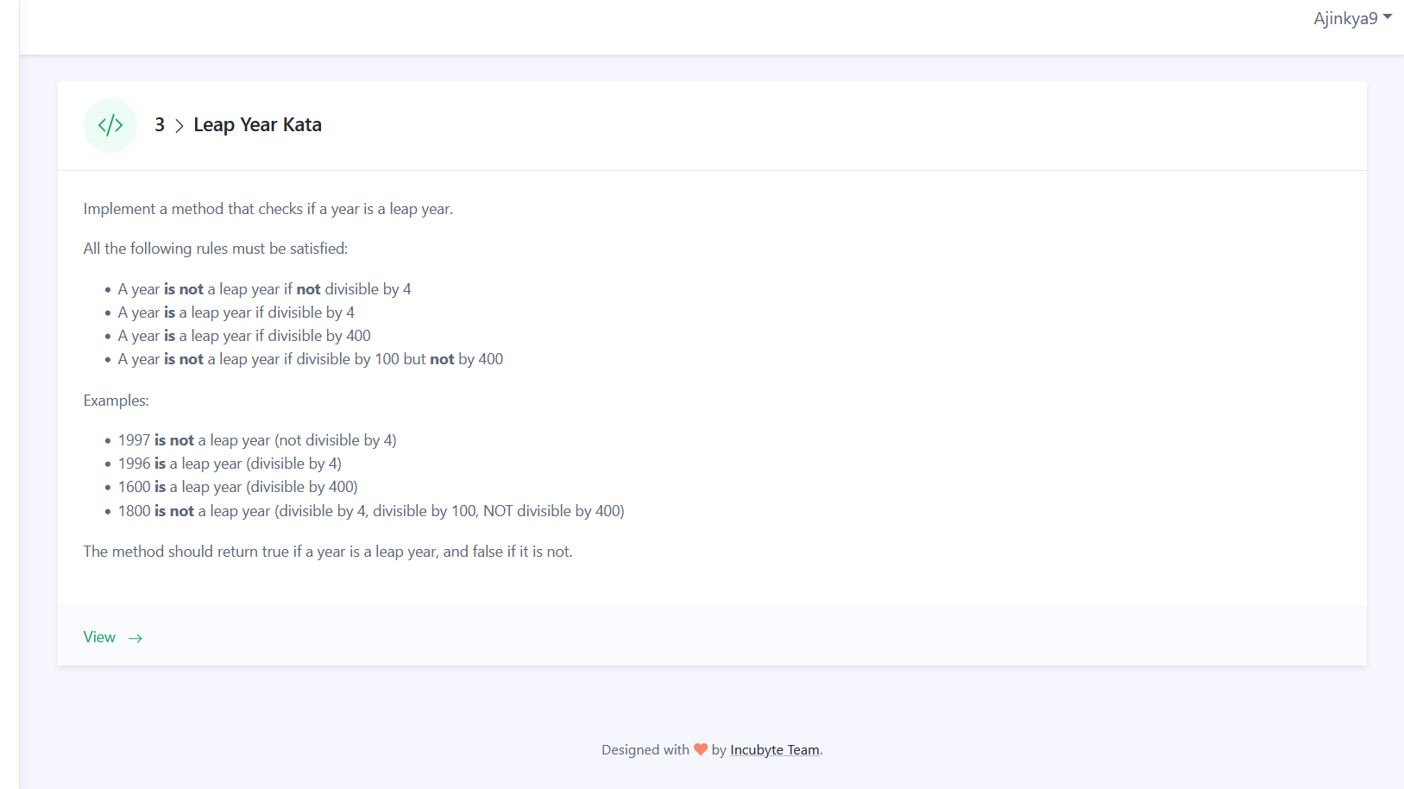

Slide 30
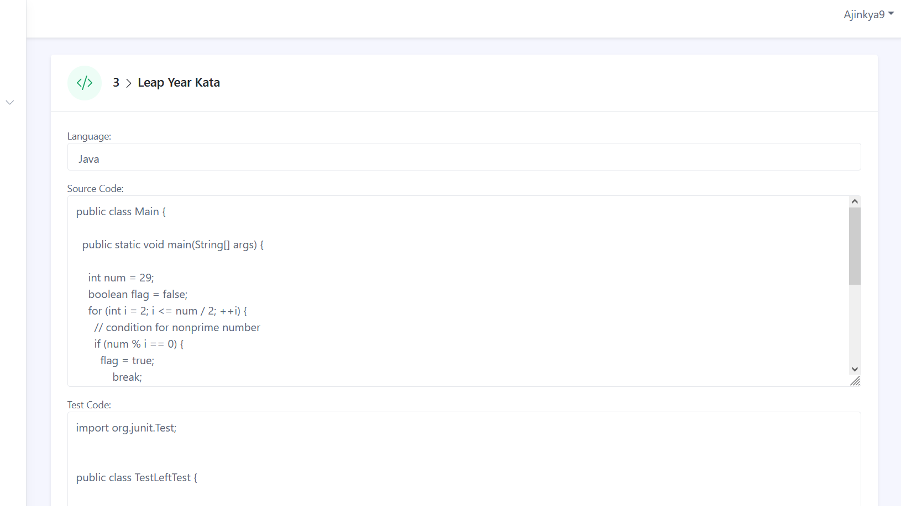

Slide 31
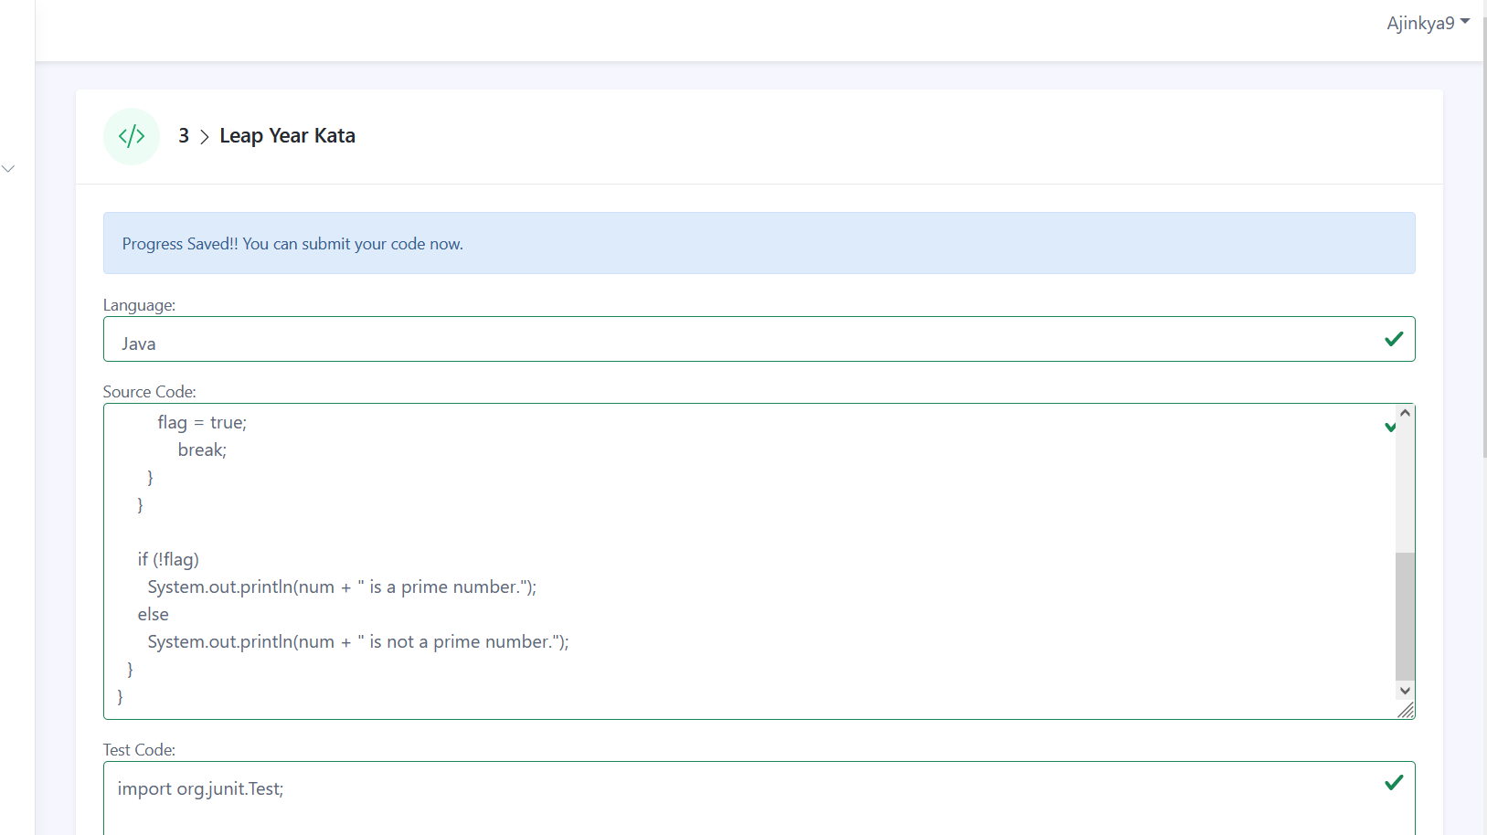

Slide 32
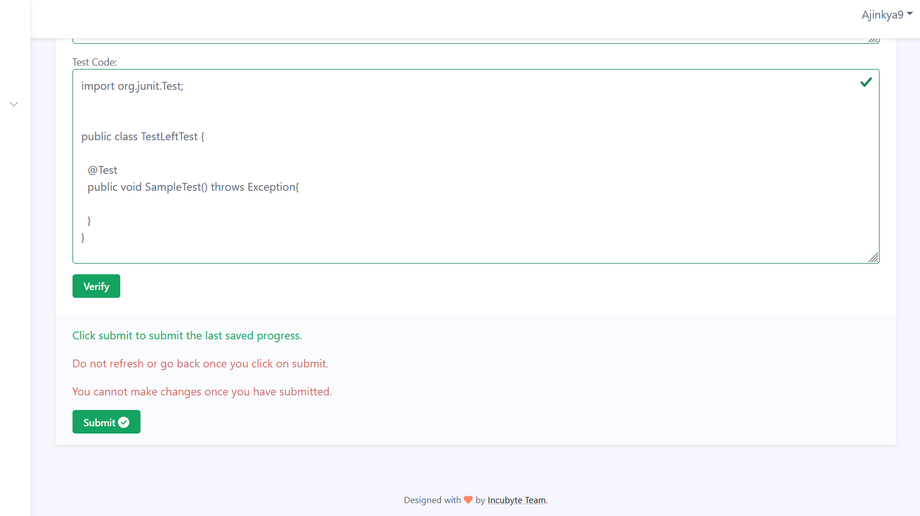

Slide 33
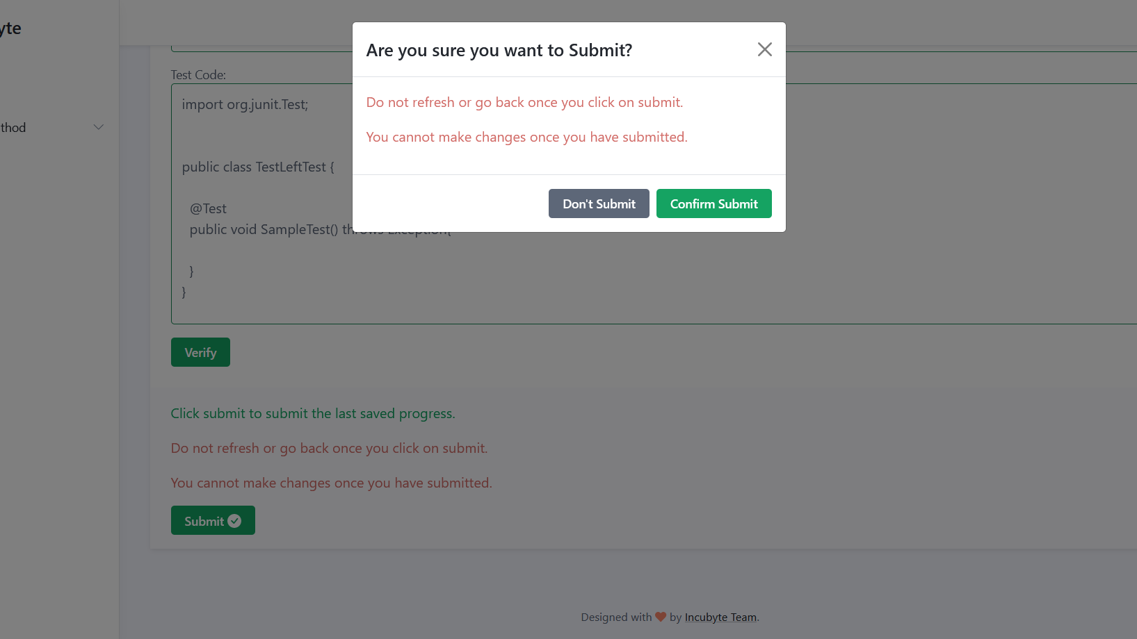

Slide 34
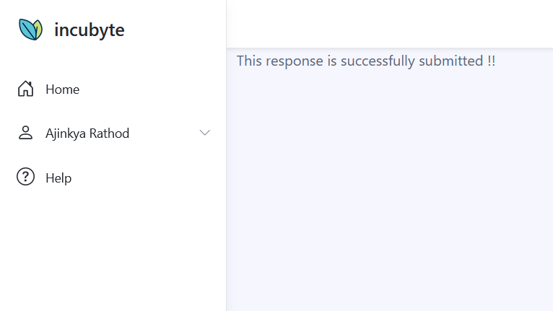

Slide 35
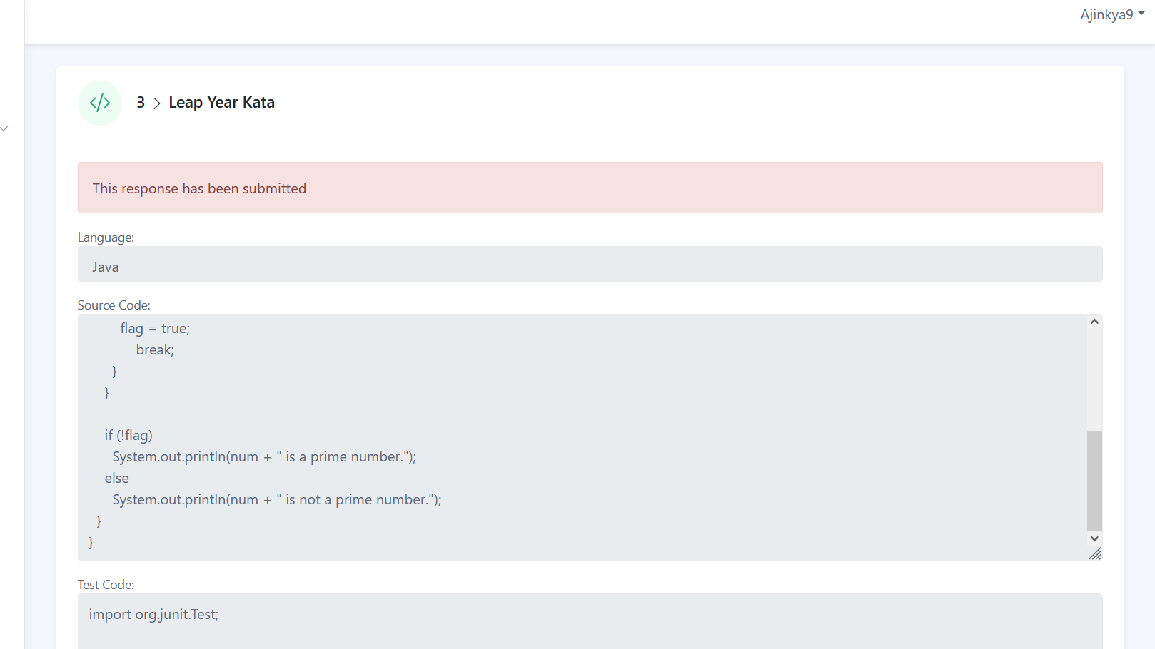

Slide 36
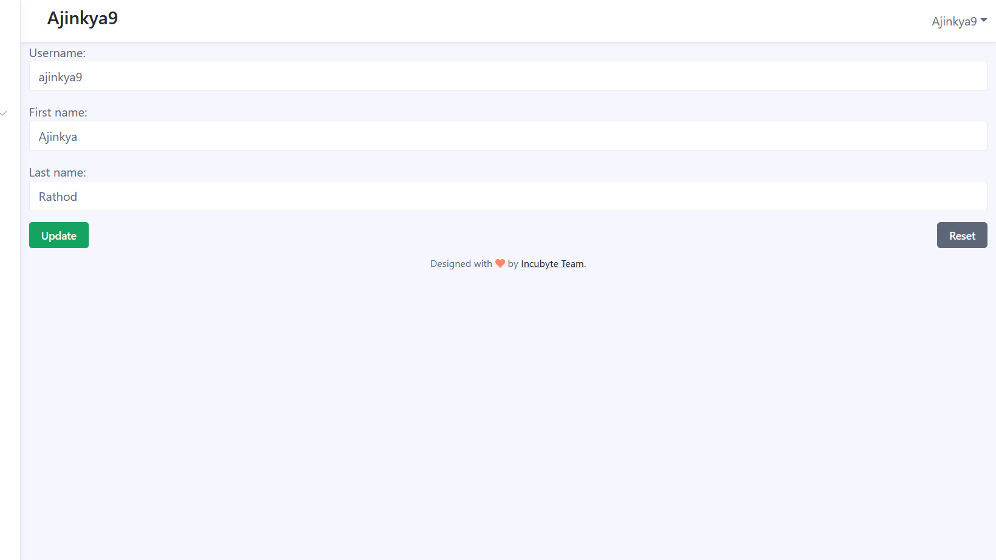

Slide 37
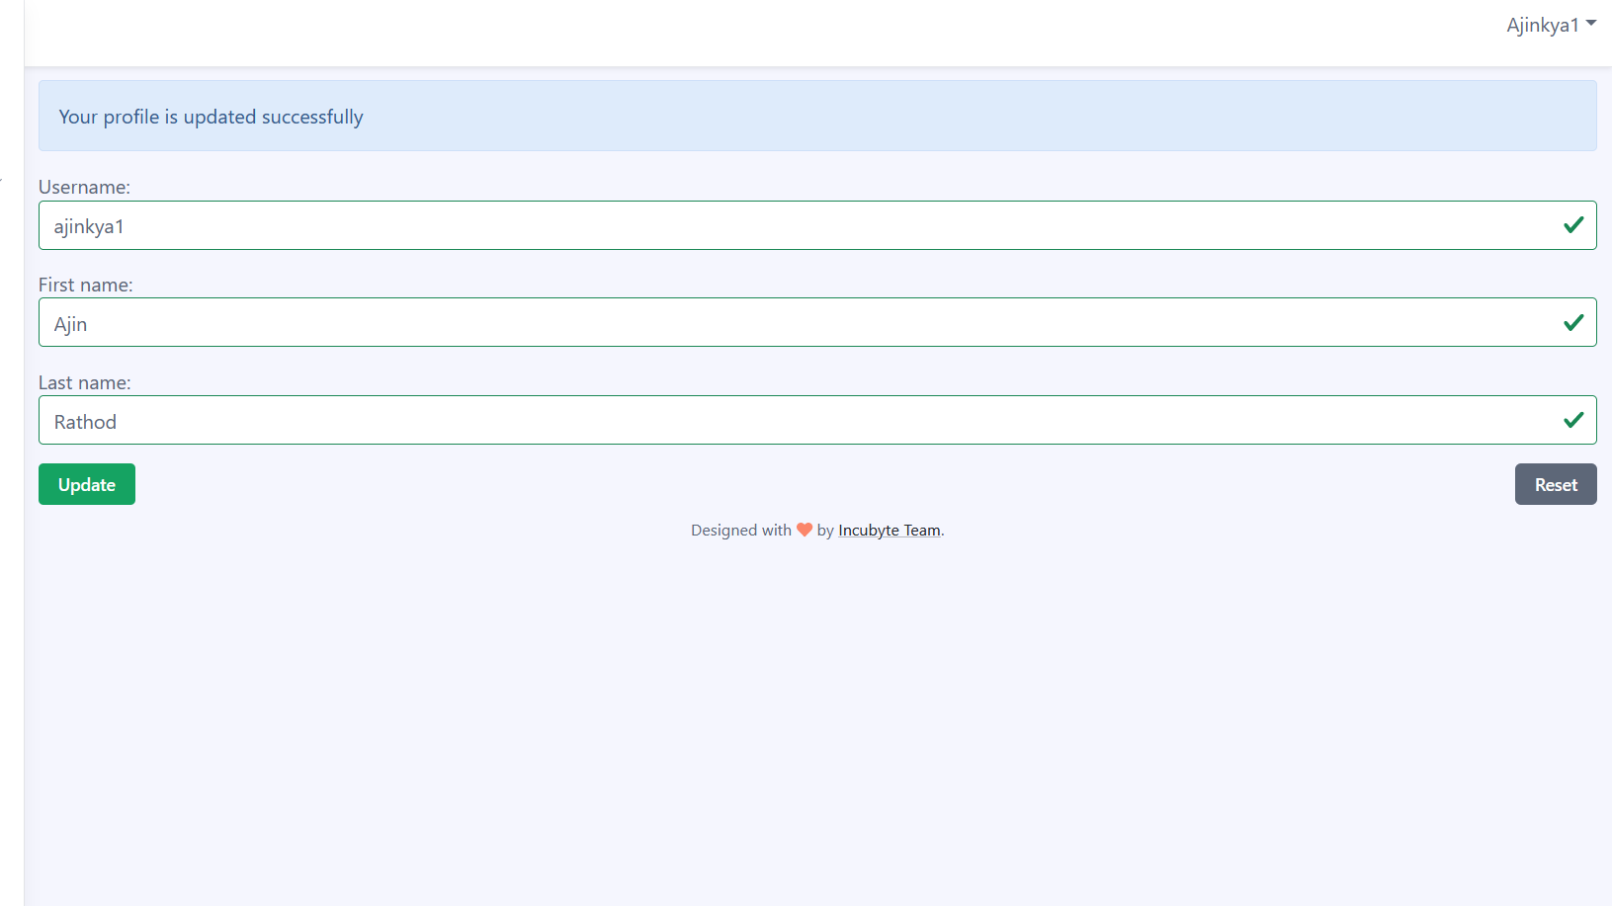

Slide 38
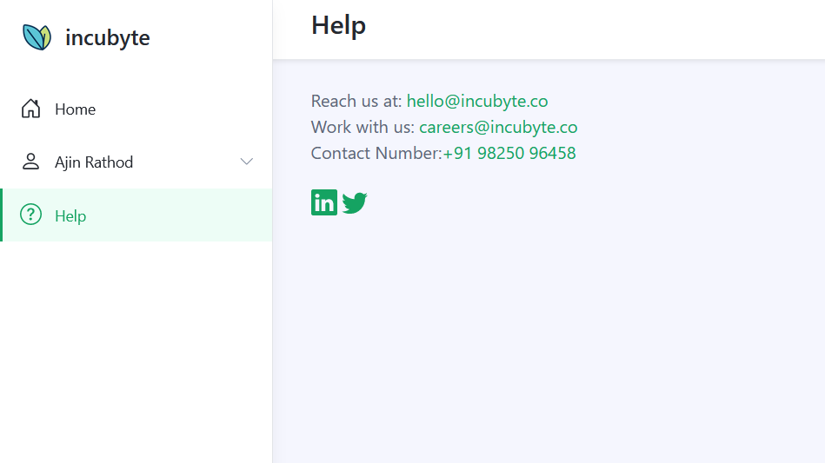

Slide 39
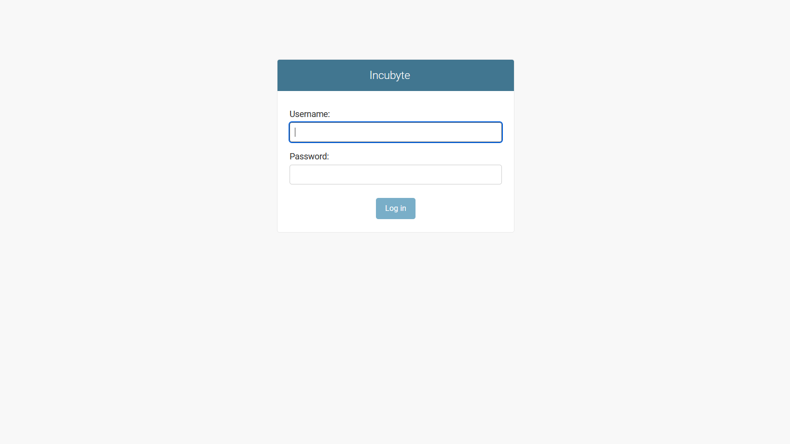

Slide 40
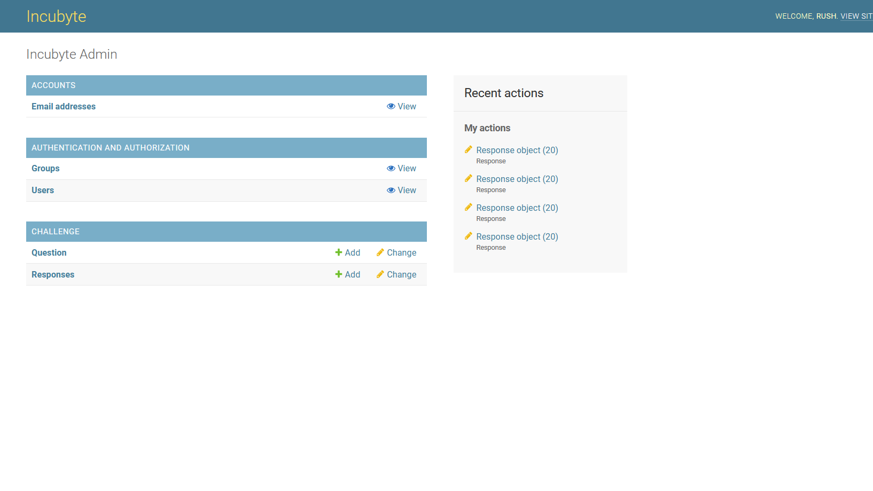

Slide 41
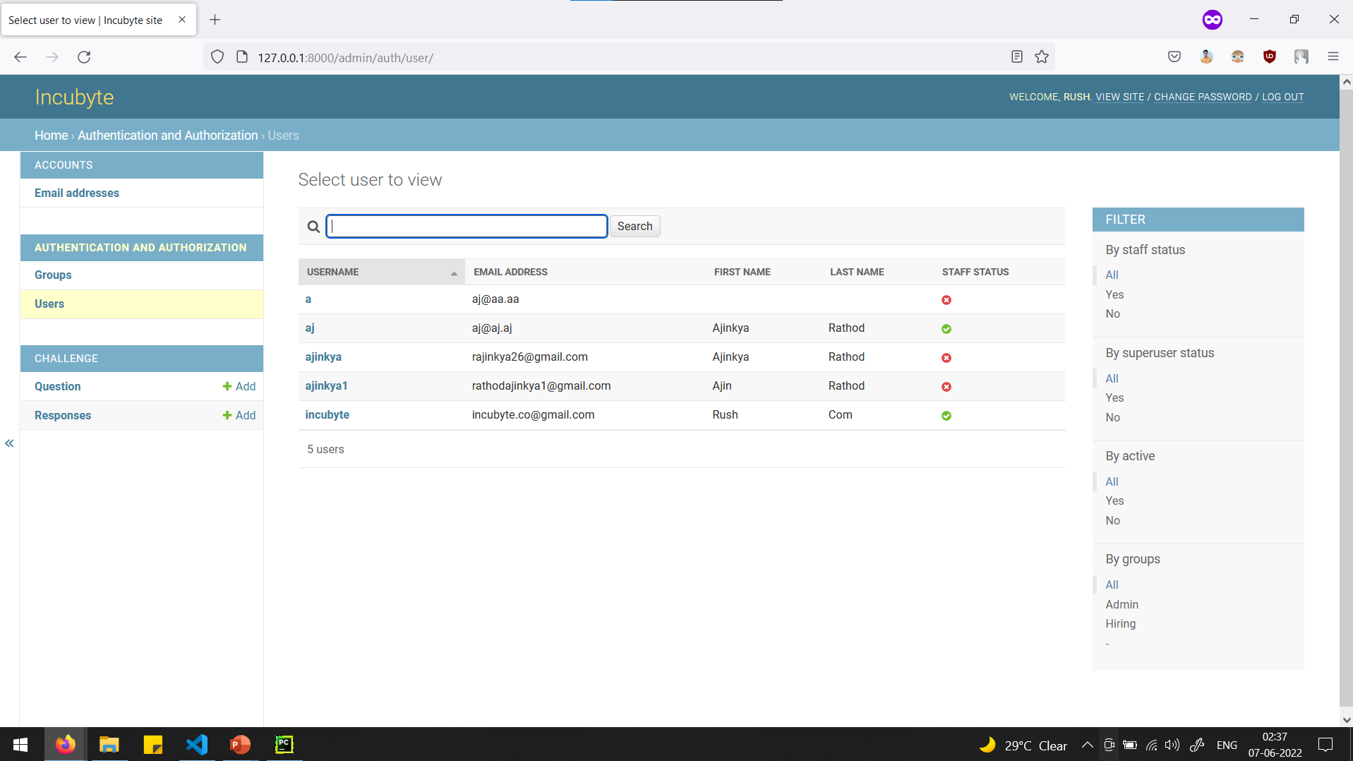

Slide 42
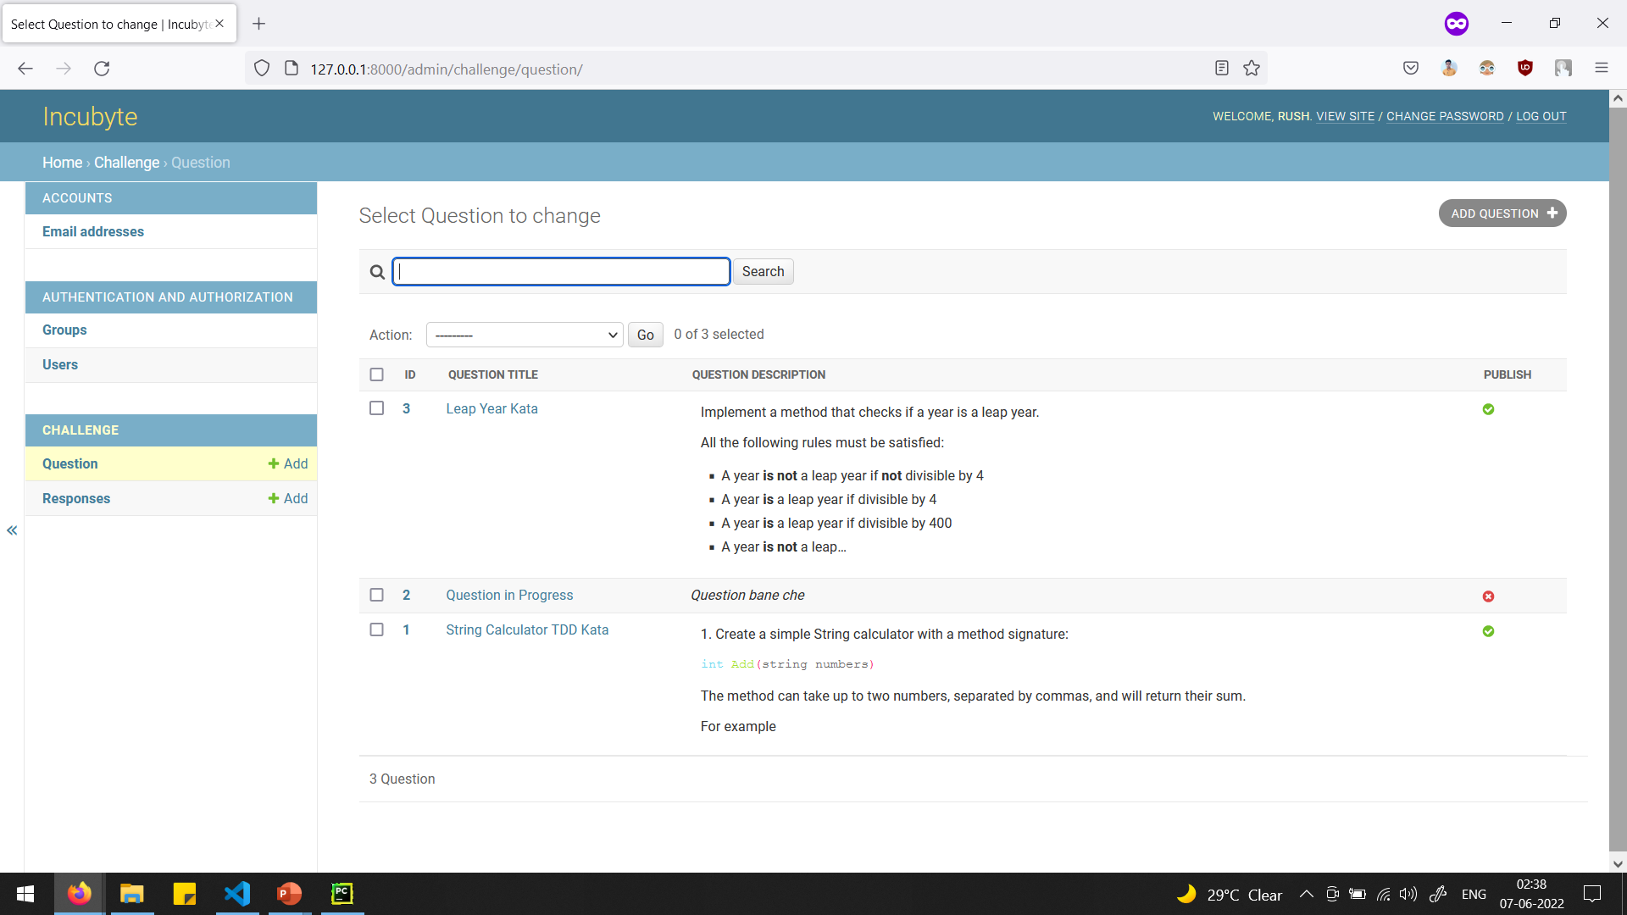

Slide 43
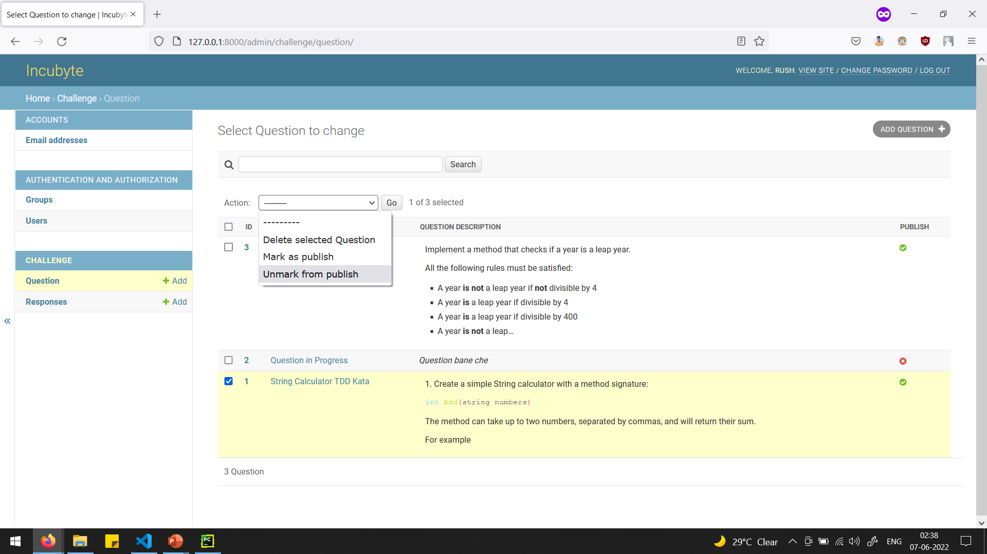

Slide 44
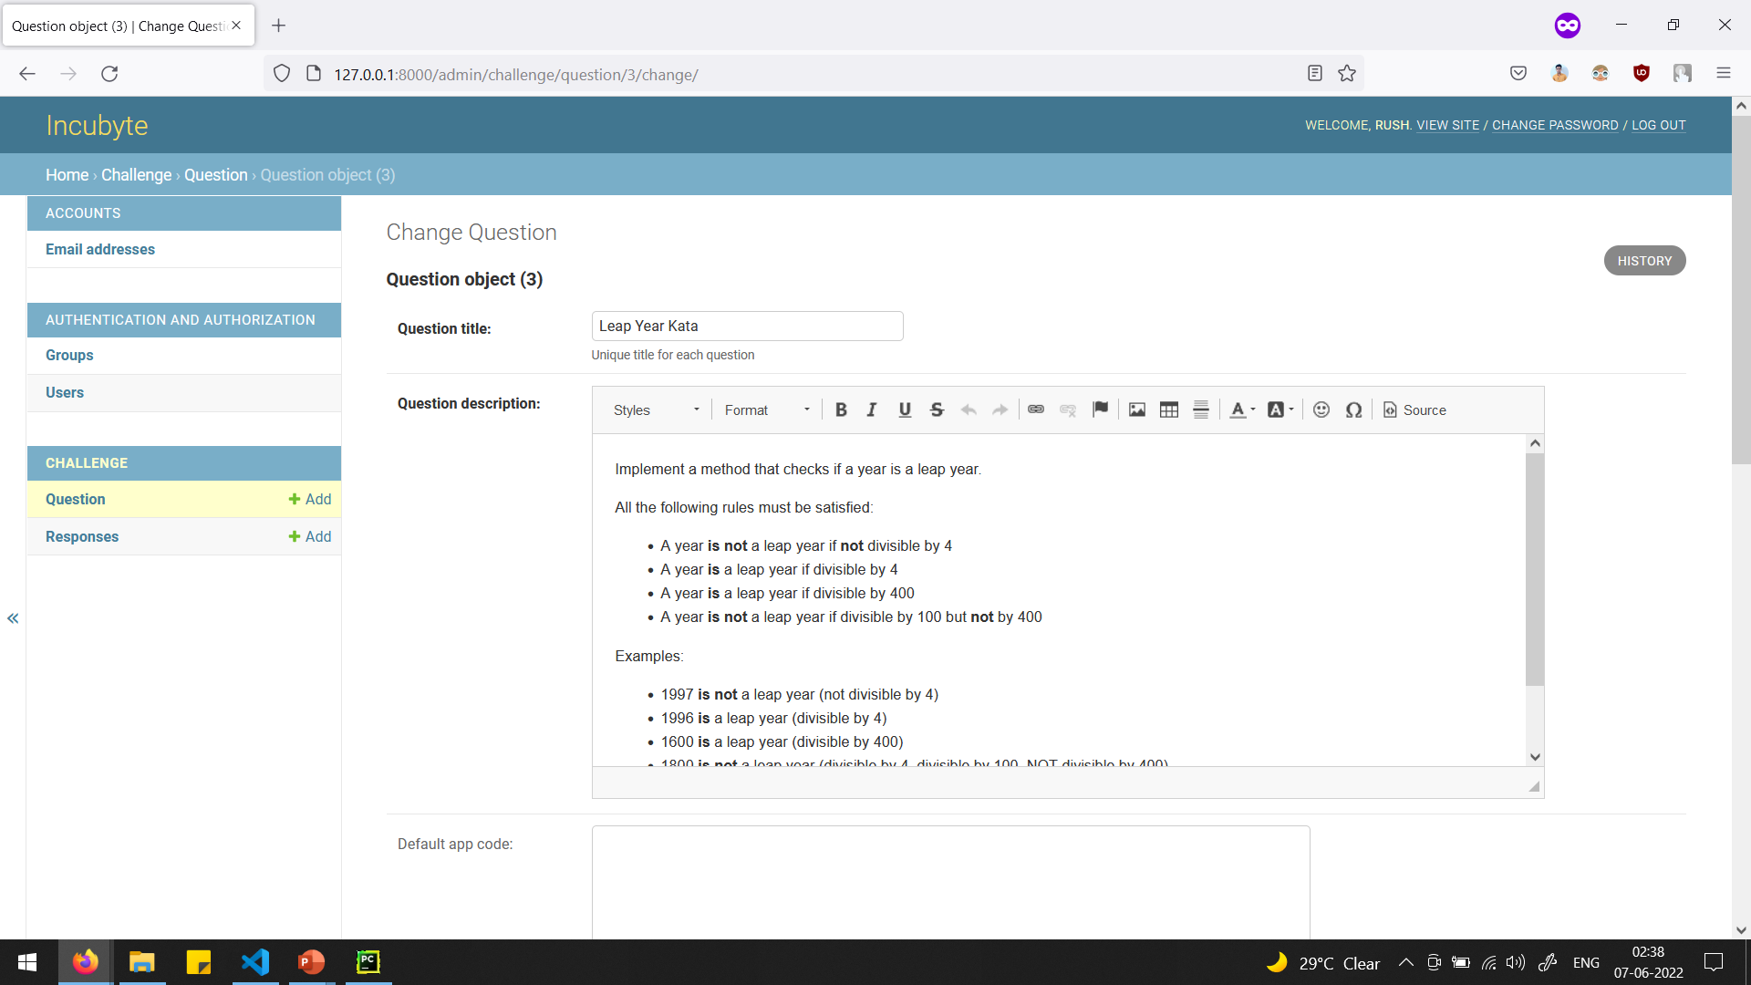

Slide 45
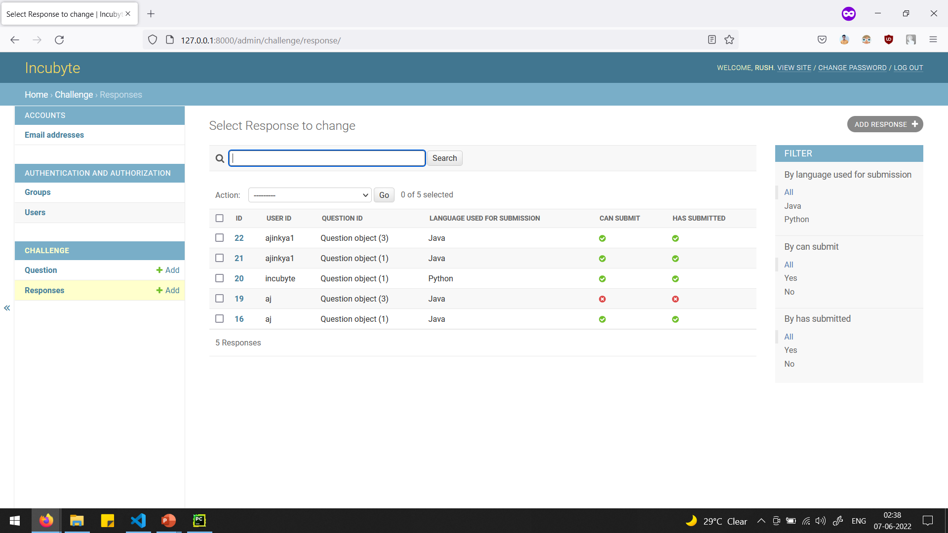

Slide 46
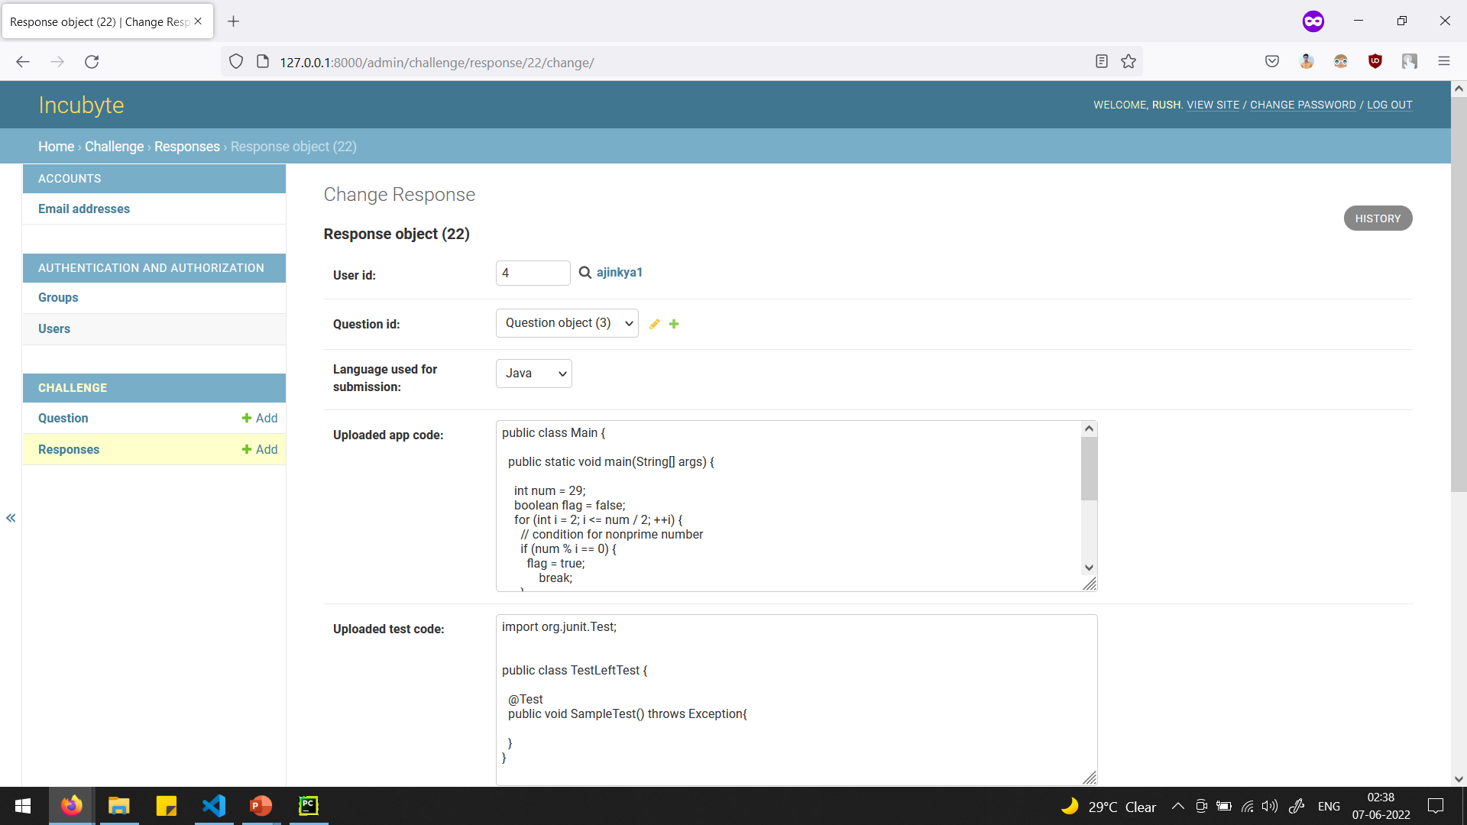

Slide 47
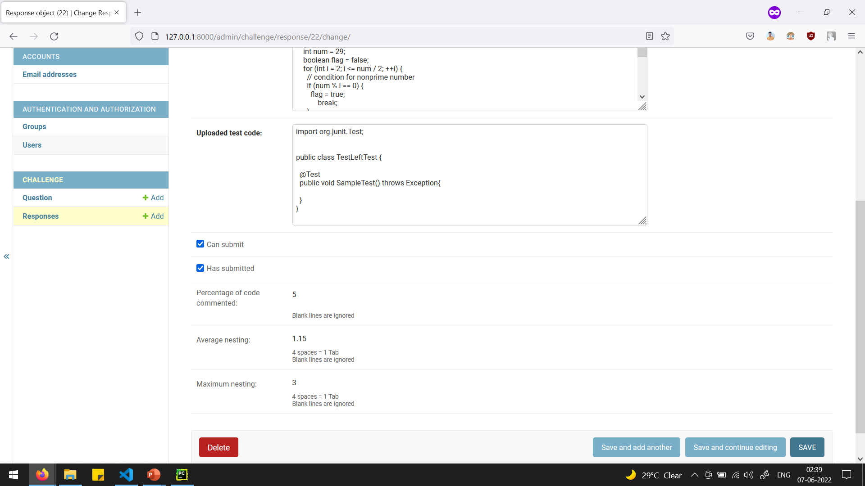

Slide 48
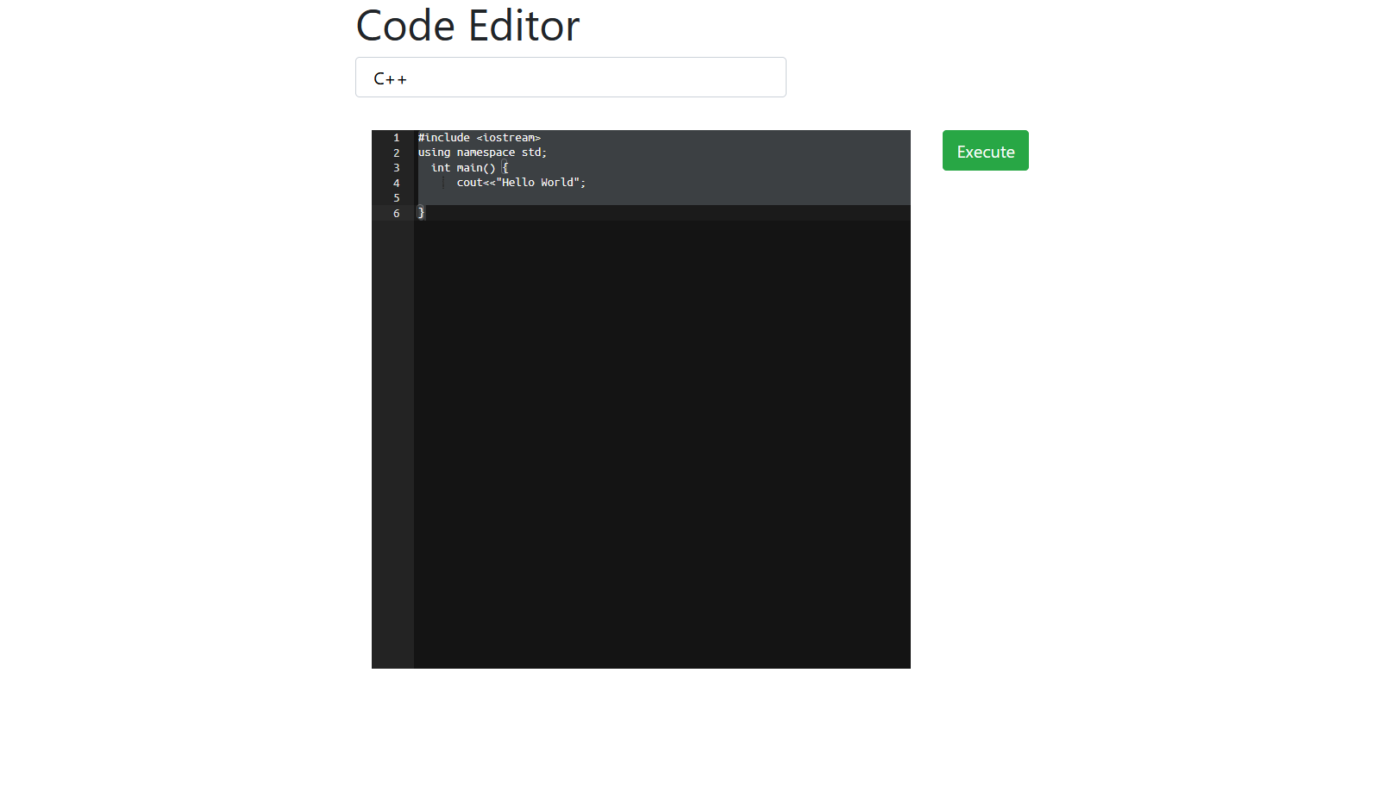

Slide 49
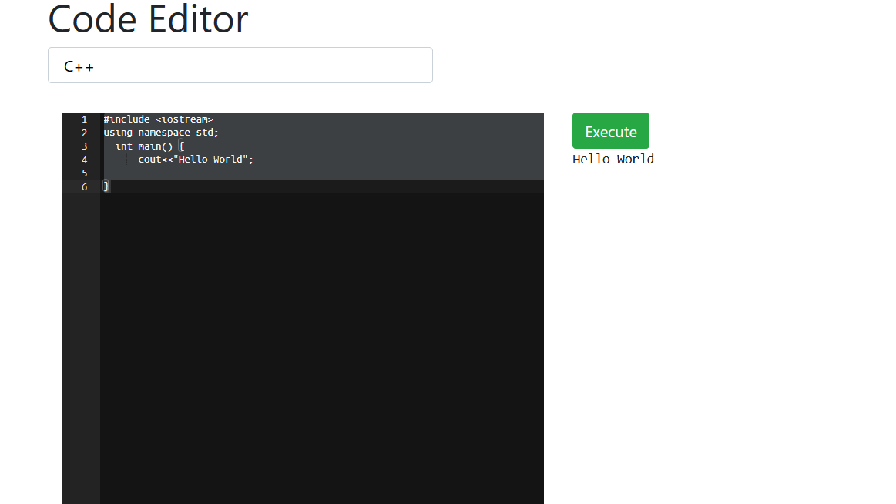

Slide 50
Future Work
We will try to accomplish each and every factor possible to check whether the code submitted is perfect as per requirement or not
Applying Machine Learning on Clean Code
Check for gibberish or misleading comments
Check if proper names are given to variables

Slide 51
Bibliography
https://www.nltk.org/

Slide 52
Thank you

